Slide 1
PMAS-Arid Agriculture University Rawalpindi
University Institute of Information Technology
Topic:Inside CPU & CPU Operations
GROUP MEMBERS:
Talha Nadeem (21-ARID-476)
Summiya Ejaz (21-ARID-514)
Shehnaz Bibi (21-ARID-511)

Slide 2
01.
Component of Computer.
02.
Instruction.
03.
Instruction cycle.
04.
Instruction cycle with
Interrupts.
table of contents

Slide 3
01.
Component of Computer:
Central Processing Unit
Input devices
Output devices

Slide 4
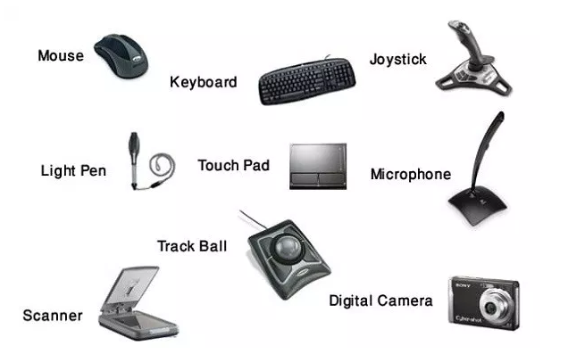
Input Unit:
A computer will only respond when a command is given to the device. These commands can be given using the input unit or the input devices. The data entered can be in the form of numbers, alphabet, images, etc.
Input devices

Slide 5
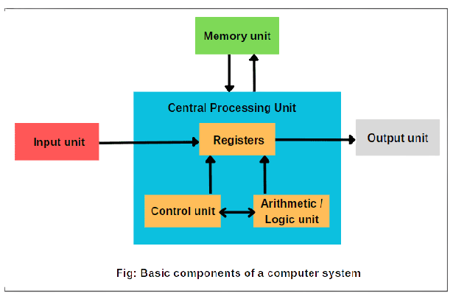
Central Processing Unit (CPU):
The Central Processing Unit is the core of any computer devices. It comprises three major components of the computer which have been discussed above:
Arithmetic and Logical Unit.
Control Unit.
Memory Unit.
Registers.
Component of CPU

Slide 6
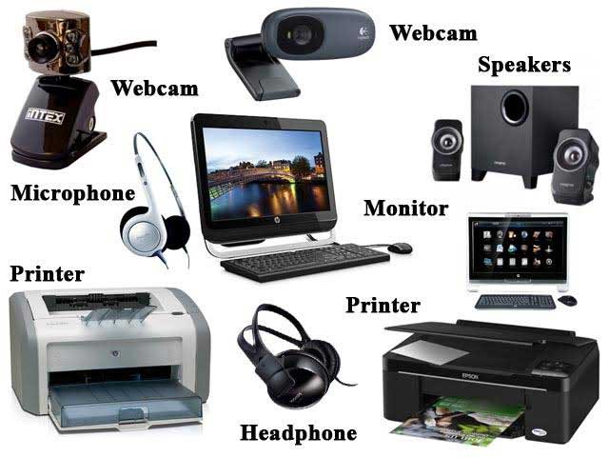
Output Unit:
The result of the command we provide the computer with through the input device is called the output. We give commands using the keyboard and after the processing, the result or outcome is displayed on the monitor.
Output devices

Slide 7
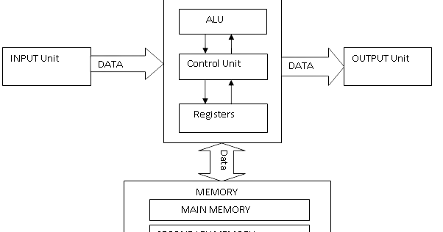
Component of Computer

Slide 8
02.
Instruction:
An instruction is a group of bits that tells the computer to perform a specific operation. Instruction of a program are stored in main memory. Instruction has two fields:
Operation code
Operand code

Slide 9
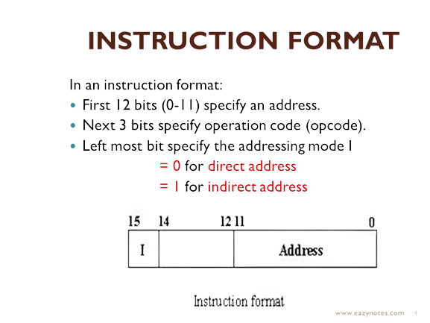
Op code

Slide 10
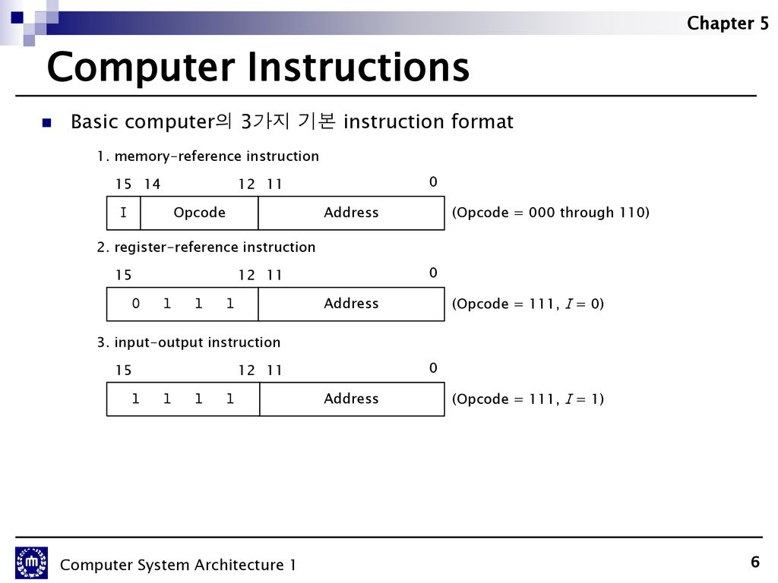
Basic Instruction Format:

Slide 11
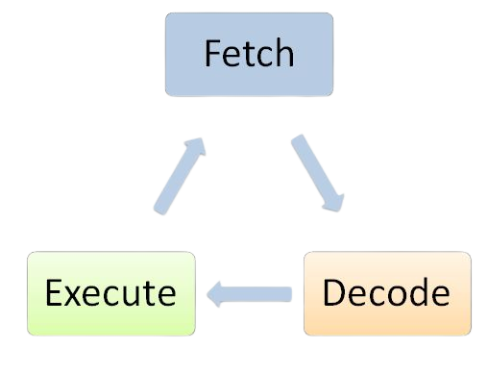
03.
Instruction cycle:
The processing involved in the execution of a single instruction is termed as Instruction Cycle. This processing is done in these steps:

Slide 12
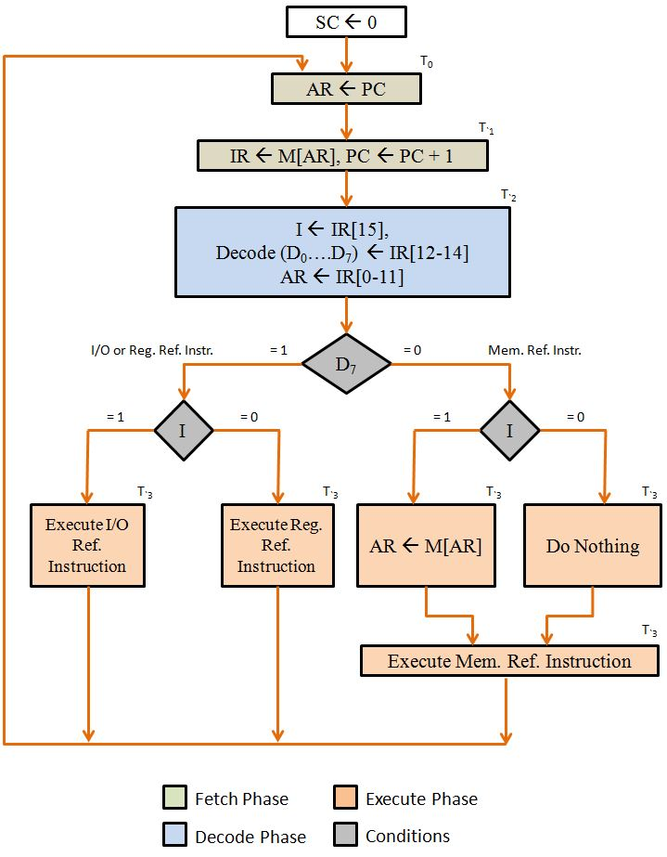

Slide 13
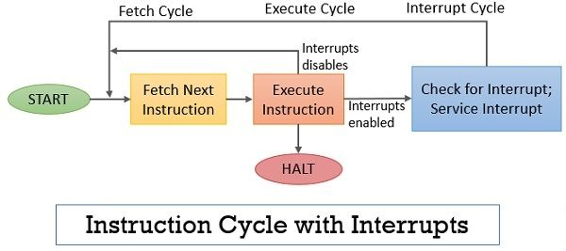
03.
Instruction cycle with interupt:
At the completion of the Execute Cycle, a test is made to determine whether any enabled interrupt has occurred or not. If an enabled interrupt has occurred then Interrupt Cycle occurs.

Slide 14

thank you!
for your interest and attention.

